Slide 1
VLM Implmentation
By Grace Xu

Slide 2
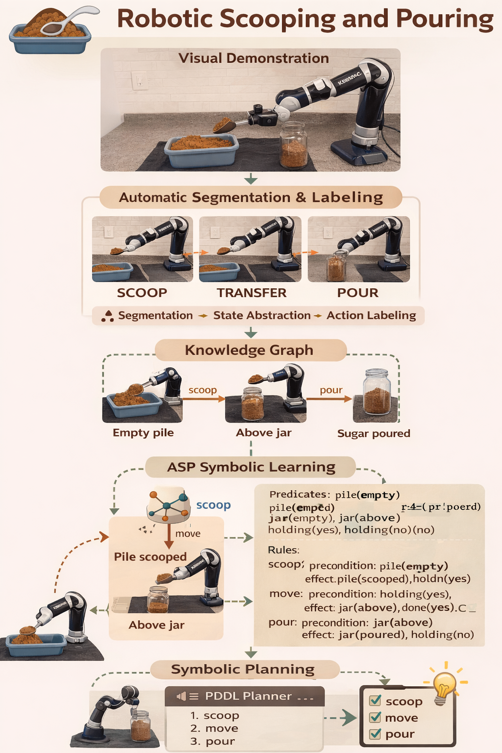
Tufts Paper Method
Raw demonstrations (images + proprioception, 1–30 per skill, no labels) → change-point detection → VLM annotation(skill classification + state equivalence) → construct and compress state-transition(knowledge Graph (KG) → ASP solver → synthesize symbolic PDDL
Domain σ=⟨E,F,S,O⟩σ=⟨E,F,S,O⟩ → Oracle extracts task-relevant objects and builds compact ego-centric observations (e.g., relative pose) → each operator is segmented into sub-skills → imitation learning (diffusion policies) using real + augmented trajectories → Transformer termination ->learns switching

Slide 3
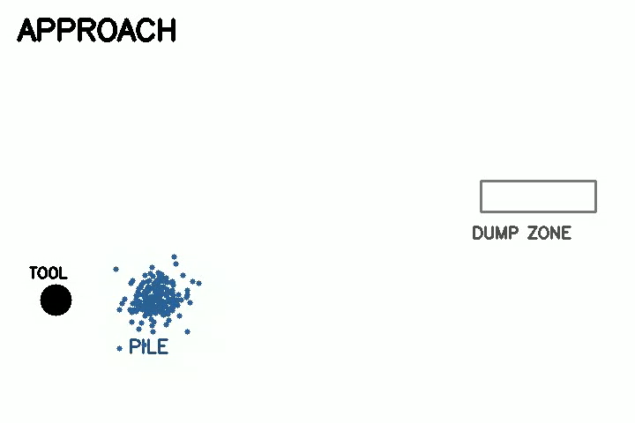
Demonstration Video
As no real data yet, a demo video was created for testing and debugging.

Slide 4
VLM Model
State representation: Each node n∈V corresponds to a visual scene snapshot (i.e., a frame captured at key transition points).
Transitions (bisimulation-based merging): Nodes are merged if a VLM determines that two snapshots represent the same high-level state, based on domain-specific hints provided in the prompt.
Skill labeling: For each demonstration segment τ, I extract representative frames and use a classification prompt with the VLM. The predicted label l^∈Λ is then assigned to the edge (n,l^,n′).

Slide 5
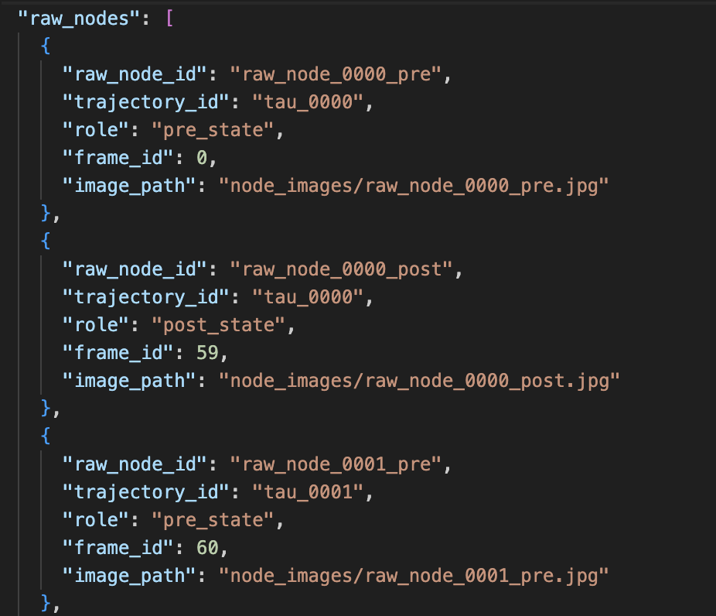
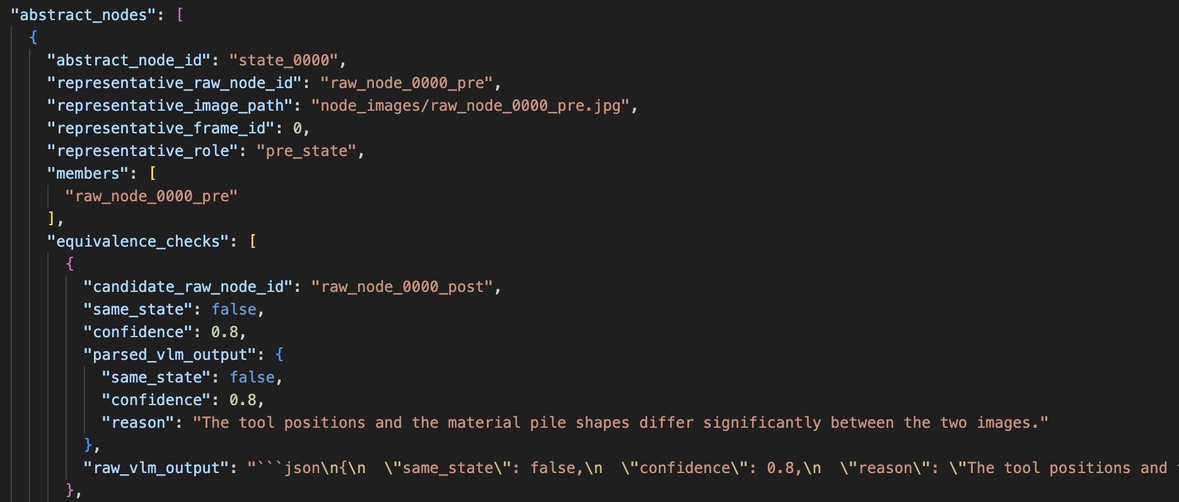
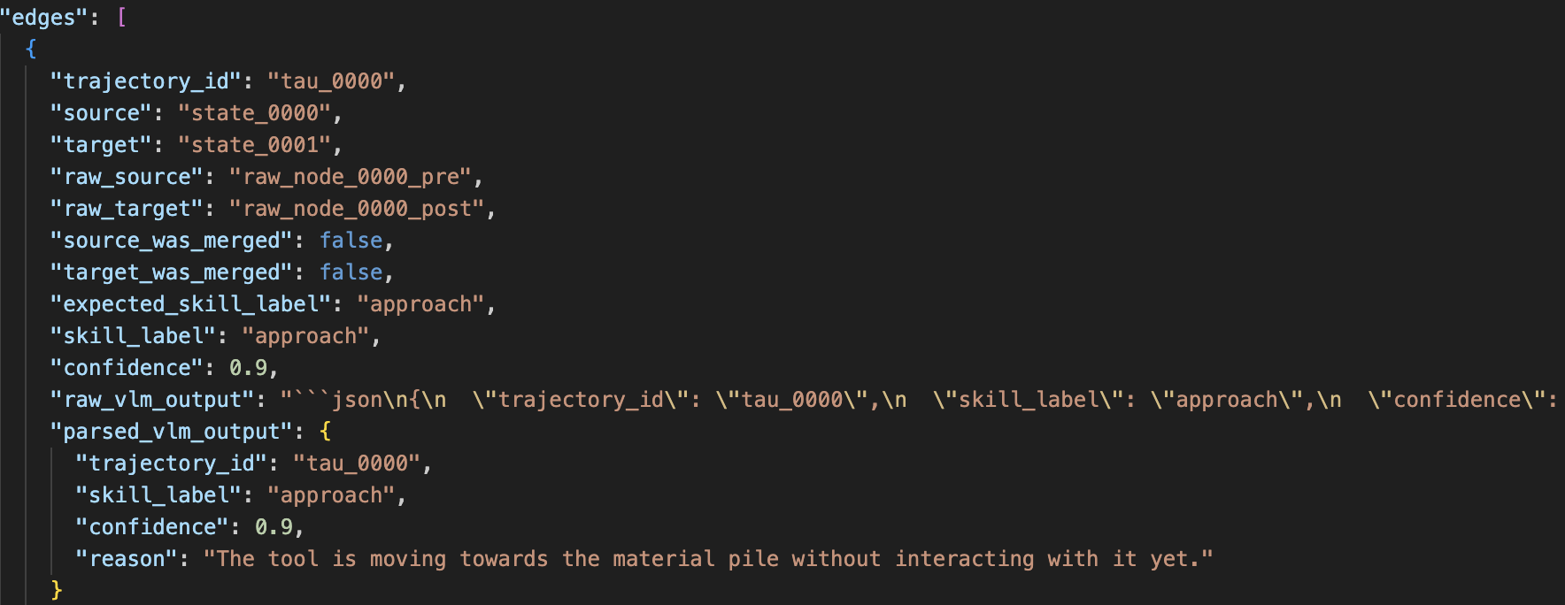
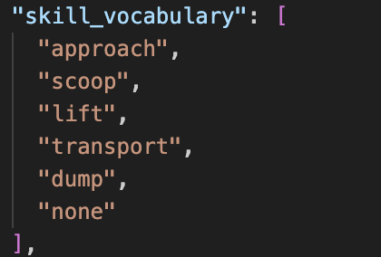
VLM Output

Slide 6
Knowledge Graph

Slide 7
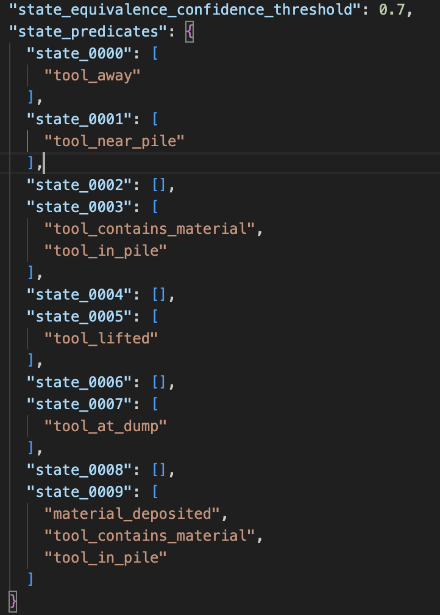
ASP Solve

Slide 8
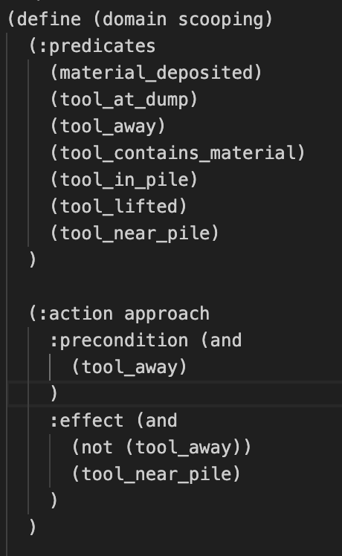
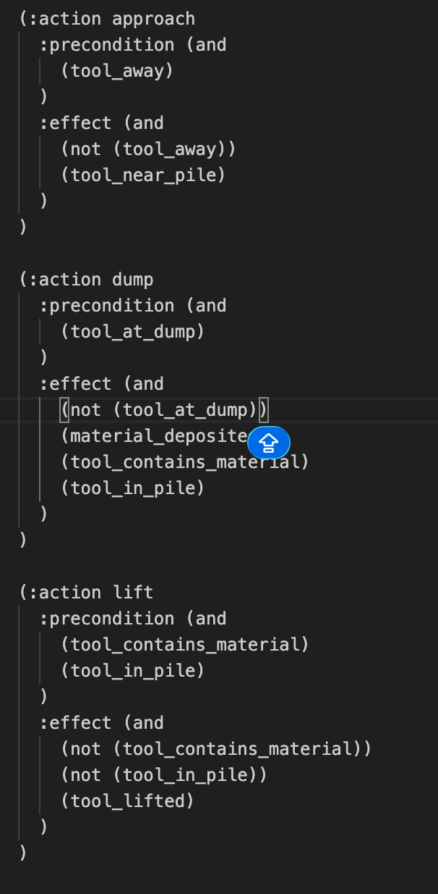
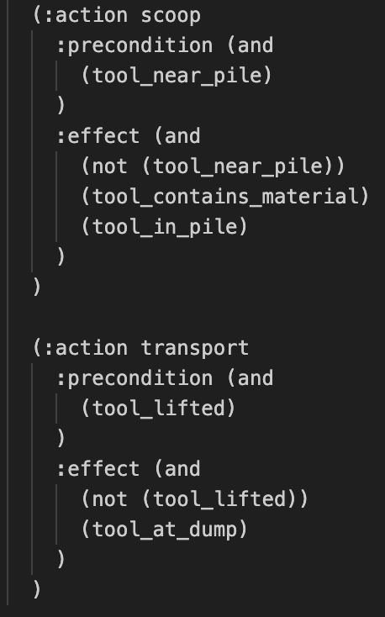
PDDL

Slide 9
Next Steps
Collect real data for our task
Test on various VLM
Compare the method used in Symskill paper: They also segment demonstration->used VLM to extract pose, motion and all other information-> jointly learns high level planning and low level skills.
Think about our contribution

Slide 10
Credit: template was created by Slidesgo
Thanks!

